Slide 1

Learning Objective
I will solve quadratic equations using the null factor law.
Enter quietly, please be ready with the following on your desk:
Whiteboard
Whiteboard marker
Exercise Book
Pencil, pen, ruler and red pen
Diary
Calculator
Device – charged or borrowed from Library before maths

Slide 2
Daily Review
Reminders:
Multiply everything in the 1st bracket by everything in the 2nd bracket$.$
Expand the brackets:
$$(t+3)(t+7)$$
What do we do with $7t$ and $3t$?
$$t$$
$$7$$
Add them.
$$t$$
$$t^{2}$$
$$7t$$
What do we do with $7$ and $3$?
$$3$$
$$3t$$
$$21$$
Multiply them.
$$=t^{2}+7t+3t+21$$
$$=t^{2}+10t+21$$

Slide 3
Daily Review
Expanding is the process where you remove the brackets.
Factorising is the reverse - you are putting the brackets in.
$$t^{2}+10t+21$$
$$t$$
We are looking for two numbers that multiply together to make 21.
1 and 21
3 and 7
$$t$$
$$t^{2}$$
$$?t$$
We are also looking for two numbers that add together to make 10.
3 and 7
$$?t$$
$$21$$

Slide 4
Daily Review
Expanding is the process where you remove the brackets.
Factorising is the reverse - you are putting the brackets in.
$$t^{2}+10t+21$$
$$t$$
$$3$$
We are looking for two numbers that multiply together to make 21.
1 and 21
3 and 7
$$t$$
$$t^{2}$$
$$3t$$
We are looking for two numbers that also add together to make 10.
3 and 7
$$7$$
$$7t$$
$$21$$
$$t^{2}+10t+21=(t+3)(t+7)$$

Slide 5
Learning Objective
CFU 1
What will we learn?
I will solve quadratic equations using the null factor law.
CFU 2
What will we learn?
CFU 3
How will we know if we’ve been successful?
Success Criteria
CFU 4
How will we know if we’ve been successful?
I will be able to:
Recognise if a parabola will have a minimum or maximum turning point.
Identify the x-intercepts of a parabola.
Identify the axis of symmetry of a parabola.

Slide 6
Activate Prior Knowledge
1 x 0 =
0 x 10 =
2 x 0 =
0 x 532 =
Anything multiplied by
zero has a value of zero!
3 x 0 =
-31 x 0 =
4 x 0 =
1084 x 0 =
5 x 0 =
-5.34 x 0 =

Slide 7

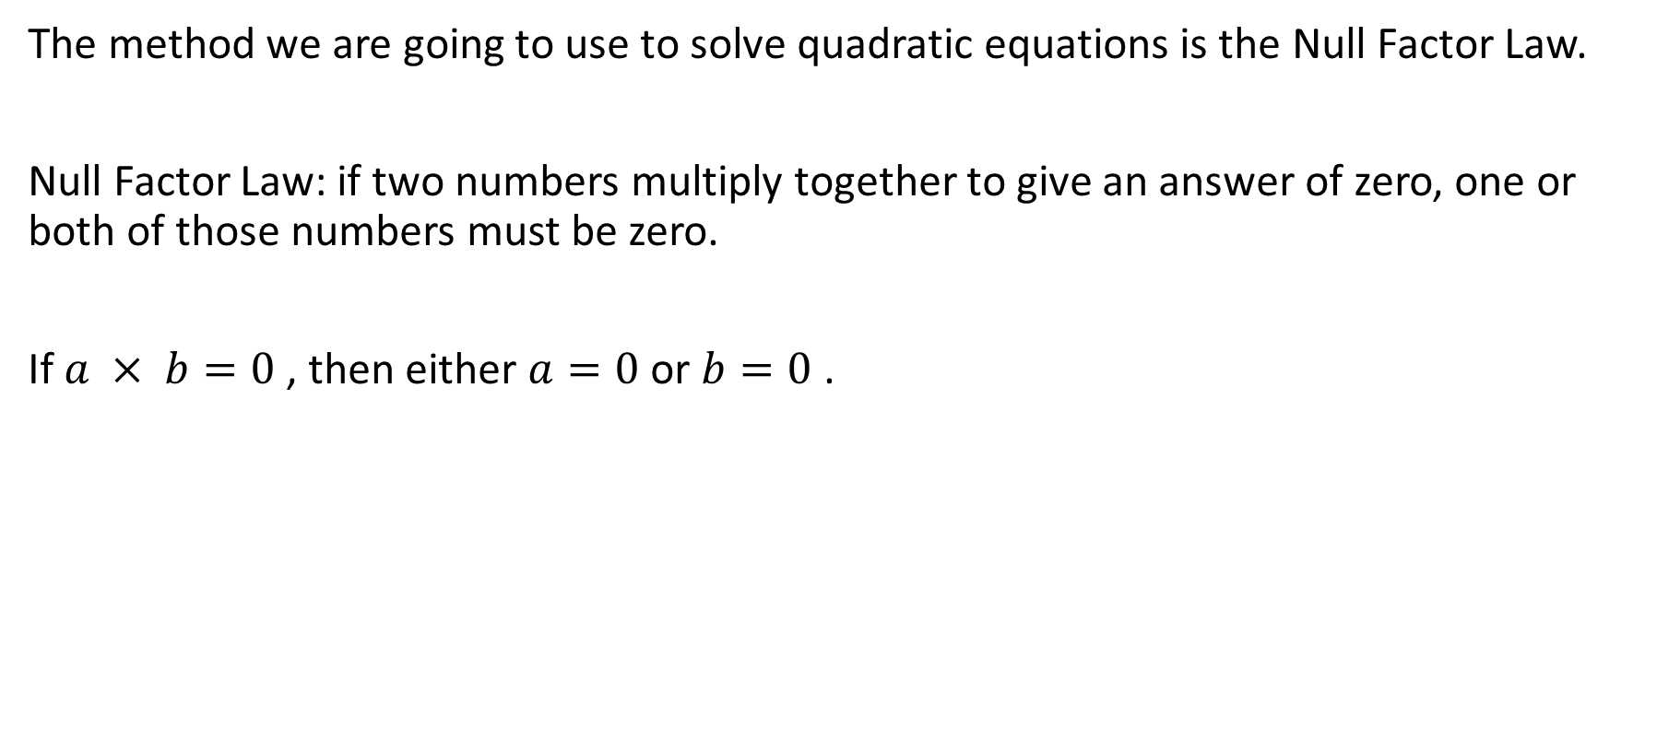
Concept Development
CFU 1
What is the null factor law?
The method we are going to use to solve quadratic equations is the Null Factor Law.
Null Factor Law: if two numbers multiply together to give an answer of zero, one or both of those numbers must be zero.
If $a × b=0$, then either $a=0$ or $b=0$ .

Slide 8
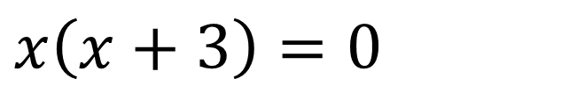



Skill Development
Null Factor Law: if two numbers multiply together to give an answer of zero, one or both of those numbers must be zero.
Solve the following quadratic equation using the null factor law.
$$x\left(x+3\right)=0$$
To give an answer of zero when multiplying, either $x=0$or $x+3=0 .$
$$x=0$$
OR
$$x+3=0$$
-3
-3
$$x=−3$$
The two solutions to the quadratic equation are $x=0$or $x=−3$ .

Slide 9

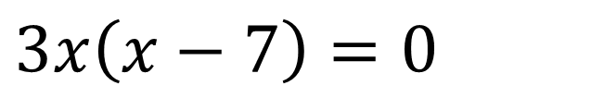





Guided Practice
Null Factor Law: if two numbers multiply together to give an answer of zero, one or both of those numbers must be zero.
Solve the following quadratic equation using the null factor law.
$$3x\left(x−7\right)=0$$
To give an answer of zero when multiplying, either $3x=0$or $x−7=0 .$
$$3x=0$$
OR
$$x−7=0$$
$$÷3$$
$$÷3$$
+7
+7
$$x=0$$
$$x=7$$
The two solutions to the quadratic equation are $x=0$or $x=7$ .

Slide 10
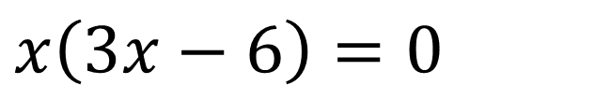




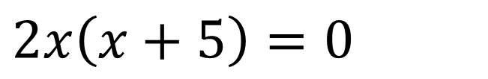
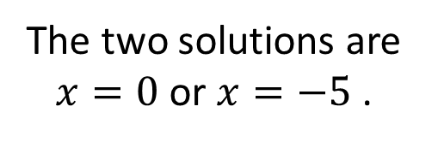

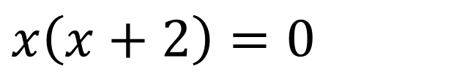


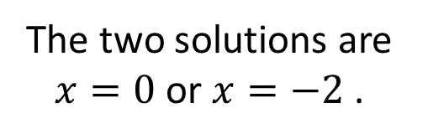








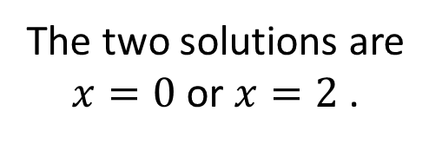
Guided Practice
Null Factor Law: if two numbers multiply together to give an answer of zero, one or both of those numbers must be zero.
Solve the following quadratic equations using the null factor law.
$$x\left(x+2\right)=0$$
$$2x\left(x+5\right)=0$$
$$x\left(3x−6\right)=0$$
$$x=0$$
OR
$$x+2=0$$
$$2x=0$$
OR
$$x+5=0$$
$$x=0$$
OR
$$3x−6=0$$
-2
-2
$$÷2$$
$$÷2$$
-5
-5
+6
+6
$$x=−2$$
$$x=0$$
$$x=−5$$
$$3x=6$$
$$÷3$$
$$÷3$$
The two solutions are $x=0$or $x=−2$ .
The two solutions are $x=0$or $x=−5$ .
$$x=2$$
The two solutions are $x=0$or $x=2$.

Slide 11

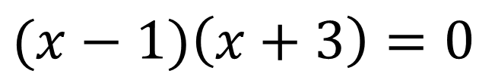

Skill Development
Null Factor Law: if two numbers multiply together to give an answer of zero, one or both of those numbers must be zero.
Solve the following quadratic equation using the null factor law.
$$(x−1)\left(x+3\right)=0$$
To give an answer of zero when multiplying, either $x−1=0$or $x+3=0 .$
$$x−1=0$$
OR
$$x+3=0$$
+1
+1
-3
-3
$$x=1$$
$$x=−3$$
The two solutions to the quadratic equation are $x=1$or $x=−3$ .

Slide 12

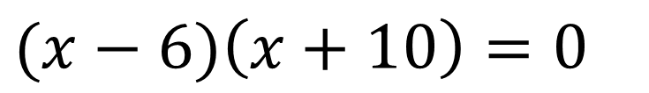



Skill Development
Null Factor Law: if two numbers multiply together to give an answer of zero, one or both of those numbers must be zero.
Solve the following quadratic equation using the null factor law.
$$(x−6)\left(x+10\right)=0$$
To give an answer of zero when multiplying, either $x−6=0$or $x+10=0 .$
$$x−6=0$$
OR
$$x+10=0$$
+6
+6
-10
-10
$$x=6$$
$$x=−10$$
The two solutions to the quadratic equation are $x=6$or $x=−10$ .

Slide 13
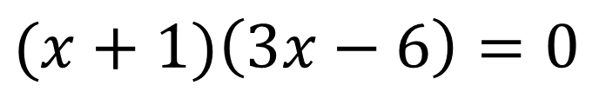


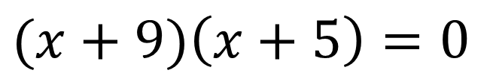
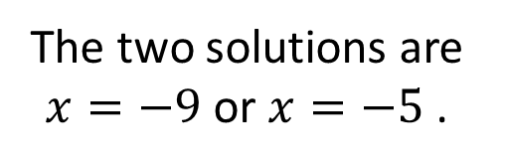
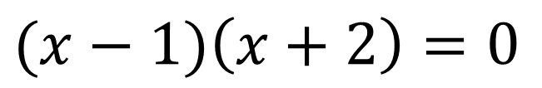

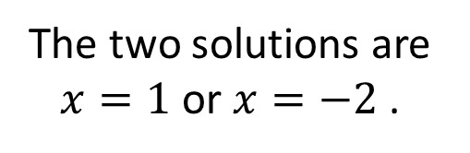






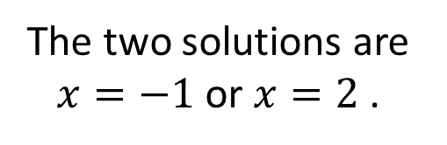
Guided Practice
Null Factor Law: if two numbers multiply together to give an answer of zero, one or both of those numbers must be zero.
Solve the following quadratic equations using the null factor law.
$$(x−1)\left(x+2\right)=0$$
$$(x+9)\left(x+5\right)=0$$
$$(x+1)\left(3x−6\right)=0$$
$$x−1=0$$
OR
$$x+2=0$$
$$x+9=0$$
OR
$$x+5=0$$
$$x+1=0$$
OR
$$3x−6=0$$
+1
+1
-2
-2
$$−9$$
$$−9$$
-5
-5
-1
-1
+6
+6
$$x=1$$
$$x=−2$$
$$x=−9$$
$$x=−5$$
$$x=−1$$
$$3x=6$$
$$÷3$$
$$÷3$$
The two solutions are $x=1$or $x=−2$ .
The two solutions are $x=−9$or $x=−5$ .
$$x=2$$
The two solutions are $x=−1$or $x=2$.

Slide 14
Independent Practice
Mathspace – Year 10 Mainstream PPT 65 Null Factor Law 1 CLASS WORK
Solve the following quadratic equation using the null factor law.
$$3x\left(x−7\right)=0$$
Null Factor Law: if two numbers multiply together to give an answer of zero, one or both of those numbers must be zero.
To give an answer of zero when multiplying, either $3x=0$or $x−7=0 .$
$$3x=0$$
OR
$$x−7=0$$
$$÷3$$
$$÷3$$
+7
+7
$$x=0$$
$$x=7$$
The two solutions to the quadratic equation are $x=0$or $x=7$ .

Slide 15
Concept Development
Reminders:
We need to find a pair of numbers that add to make the coefficient of $x$ (8) and multiply to make the constant (15).
Solve the quadratic equation $x^{2}+8x+15=0$by using the null factor law.
$$x^{2}+8x+15$$
$x$ and $x$
What do you multiply together to make $x^{2 }$?
$$x$$
$$3$$
1 and 15
3 and 5
What do you multiply together to make 15?
$$x$$
$$x^{2}$$
$$3x$$
3 and 5
What do you also add together to make 8?
$$5$$
$$5x$$
$$15$$
$$x^{2}+8x+15=\left(x+3\right)\left(x+5\right)=0$$
$$x+3=0$$
OR
$$x+5=0$$
$$−3$$
$$−3$$
-5
-5
$$x=−3$$
$$x=−5$$
The two solutions are $x=−3$or $x=−5$ .

Slide 16
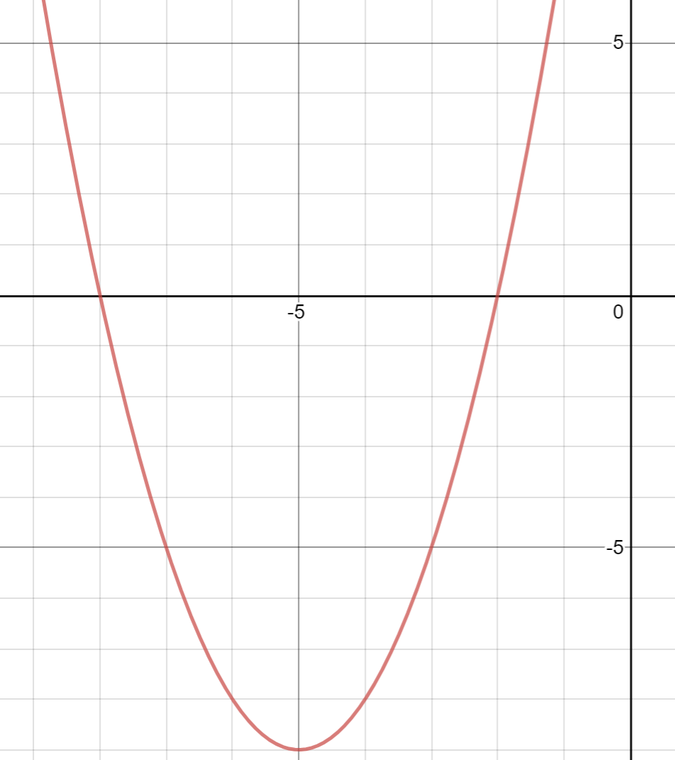
Skill Development/Guided Practice
Steps:
Step 1: Factorise the quadratic equation by finding a pair of numbers that add to make the coefficient of $x$ (10) and multiply to make the constant (16). Step 2: Set the factorised equation equal to zero and solve using the null factor law.
Solve $x^{2}+10x+16=0$
Step 1: Adds to make 10 and multiplies to make 16
8 and 2
$$x^{2}+10x+16=\left(x+8\right)\left(x+2\right)$$
$$\left(x+8\right)\left(x+2\right)=0$$
Step 2:
$$x+8=0$$
OR
$$x+2=0$$
$$−8$$
$$−8$$
-2
-2
$$x=−8$$
$$x=−2$$
The two solutions are $x=−8$or $x=−2$ .

Slide 17
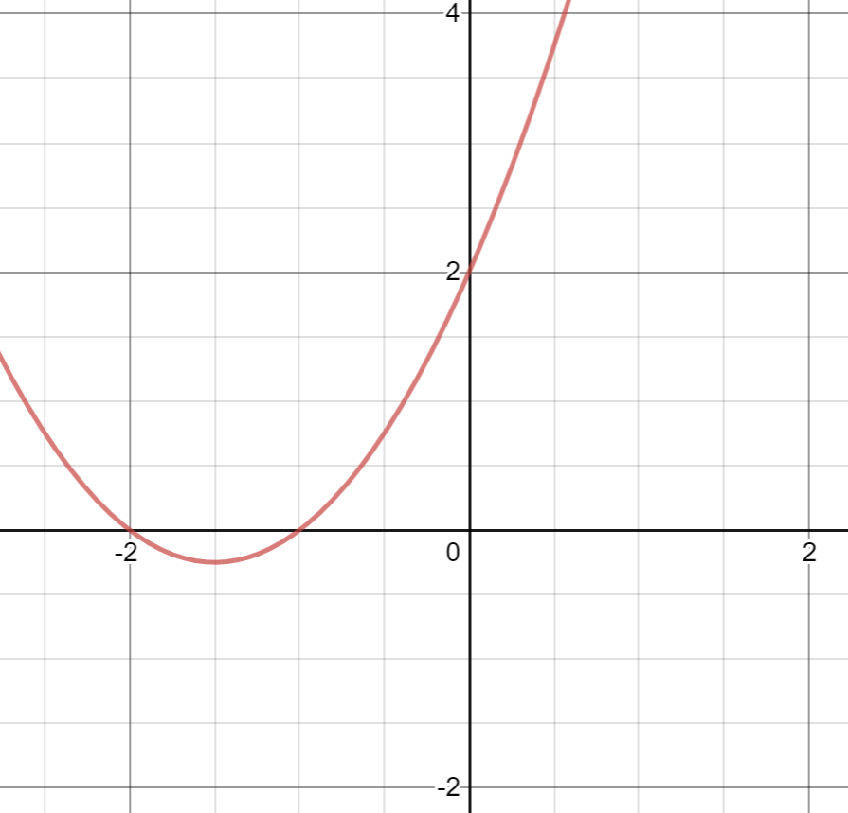
Skill Development/Guided Practice
Steps:
Step 1: Factorise the quadratic equation by finding a pair of numbers that add to make the coefficient of $x$ (3) and multiply to make the constant (2). Step 2: Set the factorised equation equal to zero and solve using the null factor law.
Solve $x^{2}+3x+2=0$
Step 1: Adds to make 3 and multiplies to make 2
1 and 2
$$x^{2}+3x+2=\left(x+1\right)\left(x+2\right)$$
$$\left(x+1\right)\left(x+2\right)=0$$
Step 2:
$$x+1=0$$
OR
$$x+2=0$$
$$−1$$
$$−1$$
-2
-2
$$x=−−1$$
$$x=−2$$
The two solutions are $x=−1$or $x=−2$ .

Slide 18
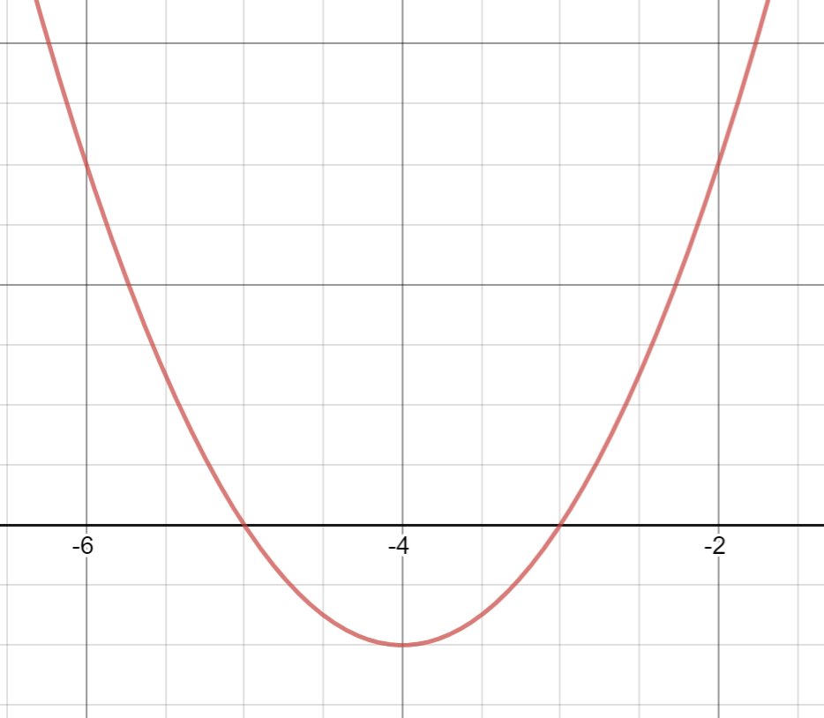
Skill Development/Guided Practice
Steps:
Step 1: Factorise the quadratic equation by finding a pair of numbers that add to make the coefficient of $x$ (8) and multiply to make the constant (15). Step 2: Set the factorised equation equal to zero and solve using the null factor law.
Solve $x^{2}+8x+15=0$
Step 1: Adds to make 8 and multiplies to make 15
5 and 3
$$x^{2}+8x+15=\left(x+5\right)\left(x+3\right)$$
$$\left(x+5\right)\left(x+3\right)=0$$
Step 2:
$$x+5=0$$
OR
$$x+3=0$$
$$−5$$
$$−5$$
-3
-3
$$x=−5$$
$$x=−3$$
The two solutions are $x=−5$or $x=−3$ .

Slide 19
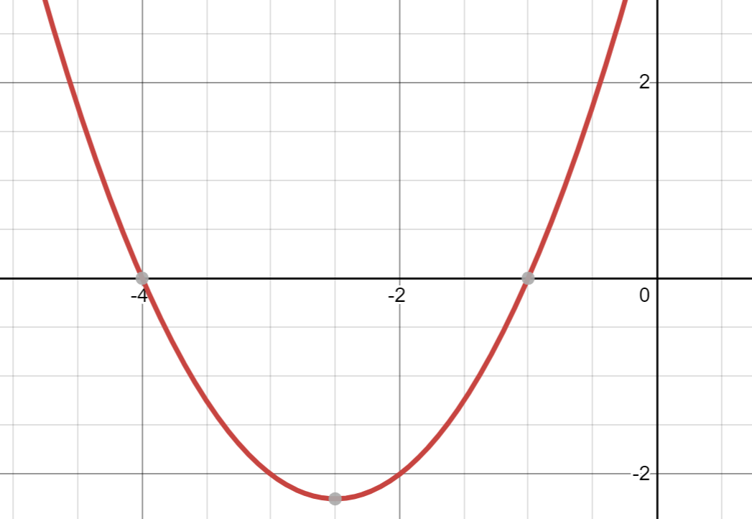
Skill Development/Guided Practice
Steps:
Step 1: Factorise the quadratic equation by finding a pair of numbers that add to make the coefficient of $x$ (5) and multiply to make the constant (4). Step 2: Set the factorised equation equal to zero and solve using the null factor law.
Solve $x^{2}+5x+4=0$
Step 1: Adds to make 5 and multiplies to make 4
4 and 1
$$x^{2}+5x+4=\left(x+4\right)\left(x+1\right)$$
$$\left(x+4\right)\left(x+1\right)=0$$
Step 2:
$$x+4=0$$
OR
$$x+1=0$$
$$−4$$
$$−4$$
-1
-1
$$x=−4$$
$$x=−1$$
The two solutions are $x=−4$or $x=−1$ .

Slide 20
Independent Practice
Mathspace – Year 10 Mainstream PPT 66 Null Factor Law 2 CLASS WORK
Steps:
Step 1: Factorise the quadratic equation by finding a pair of numbers that add to make the coefficient of $x$ (5) and multiply to make the constant (4). Step 2: Set the factorised equation equal to zero and solve using the null factor law.
Solve $x^{2}+5x+4=0$
Step 1: Adds to make 5 and multiplies to make 4
4 and 1
$$x^{2}+5x+4=\left(x+4\right)\left(x+1\right)$$
$$\left(x+4\right)\left(x+1\right)=0$$
Step 2:
$$x+4=0$$
OR
$$x+1=0$$
$$−4$$
$$−4$$
-1
-1
$$x=−4$$
$$x=−1$$
The two solutions are $x=−4$or $x=−1$ .

Slide 21
Independent Practice
Mathspace task – Year 10 Mainstream Solving Monic Quadratics CLASSWORK

